Slide 1
CIS444 final project
Group member: Shania T.Daley, MinYen Chiang

Slide 2


Competitors:feedS
Feeds is an ‘all-in-one’ social media integrator mobile app. With the ‘Feeds!’ Social Media Mobile App, you don’t have to separately deal with each social media, because they are all under one umbrella now.
This application is most similar to our app idea but we are significantly improving user productivity and time usefulness by implementing the reminder portion of the program. Visually it will be more user friendly and accepting with the implementation of the card deck. Location services will be connected to show news just for the user! No need to see local news related to other states or cities. We will be using repost, share, and comment features as this app does.

Slide 3

Urfeeds
UrFeeds is an application that will be a combination of current apps that focus on News and Social media feeds. The use of swiping motions and PageView to move through each page and between social accounts makes it one of a kind. New features will be implemented, such as a setting timer that will remind you to stop procrastinating and step away from the phone. These reminders will be presented in the form of a notification with a funny message.

Slide 4
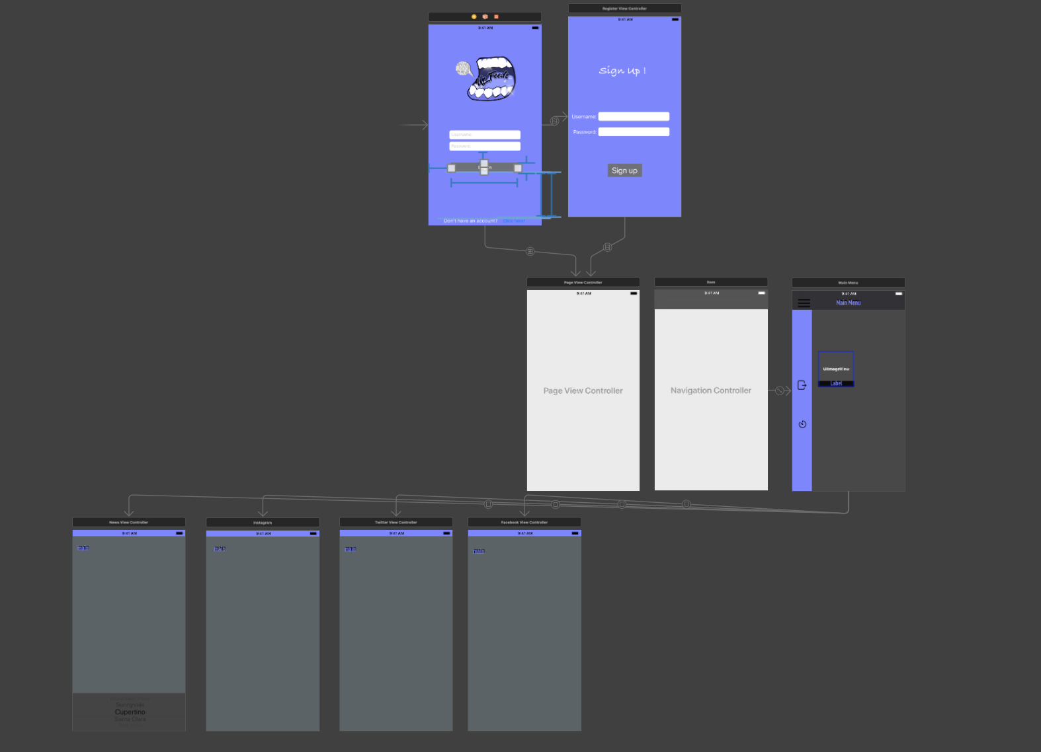
Overall

Slide 5
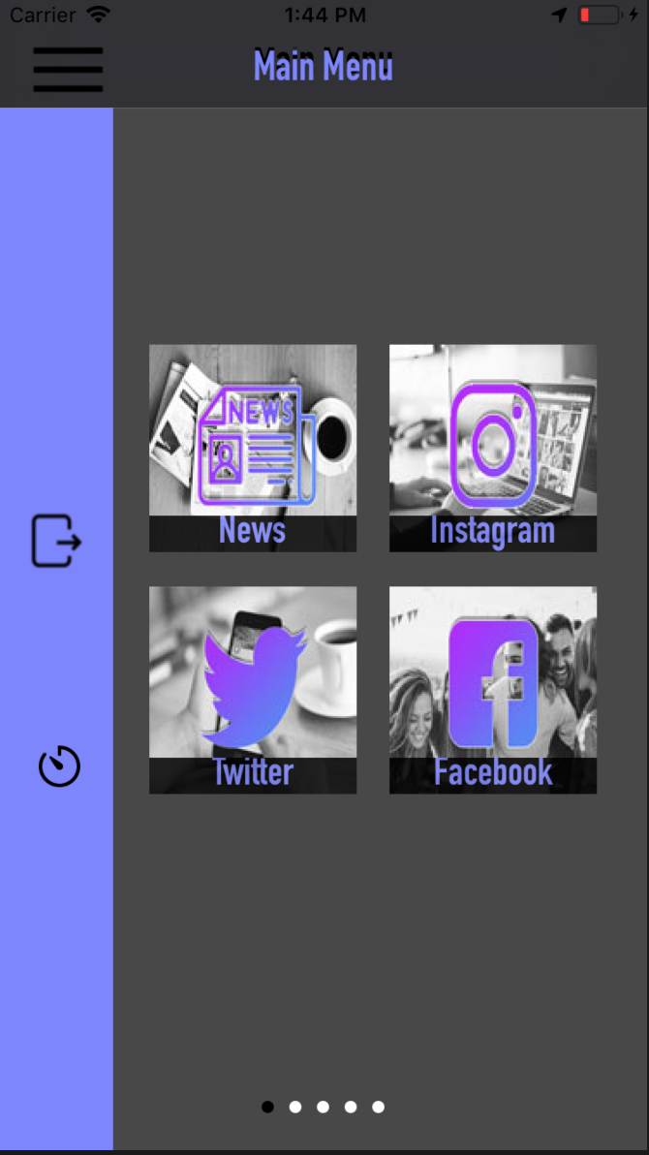
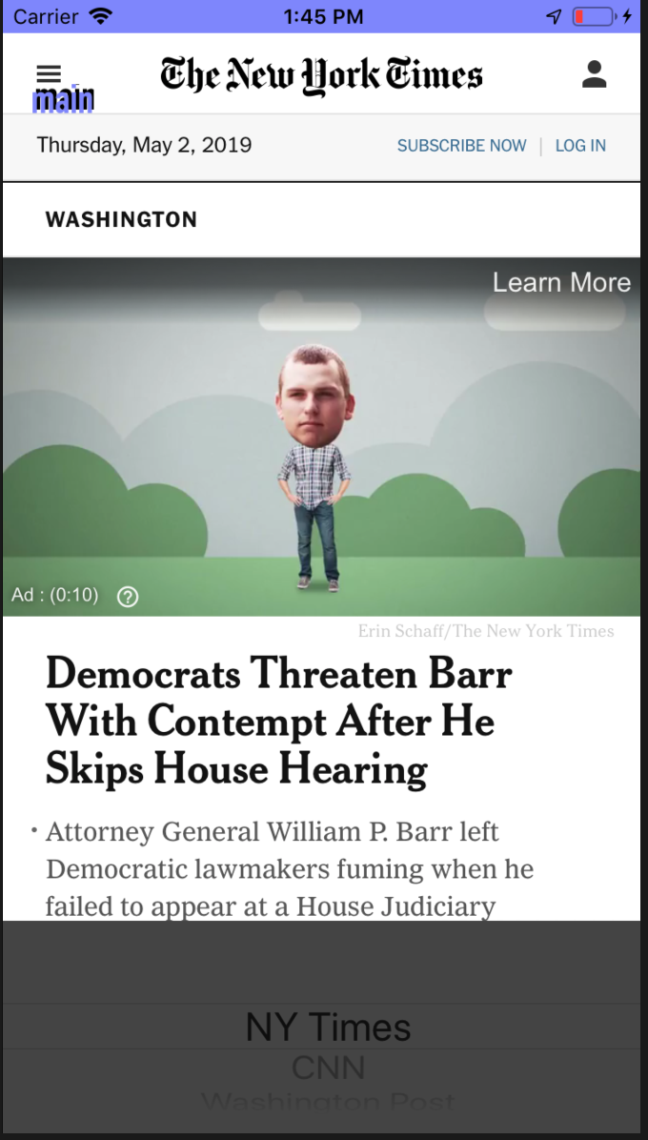
tECHNICAL fUNCTIONS
Implementing Coredata to save and fetch user data.
Animations: Slide out Navigation bar, Page View Controller(swiping out transition)
PickerViews: news from different source websites to choose
CollectionViews
WKWebKit: Instagram, Facebook, Twitter, etc.
CoreLocation: getting users live location, updates new location when user moved 10000meters.

Slide 6
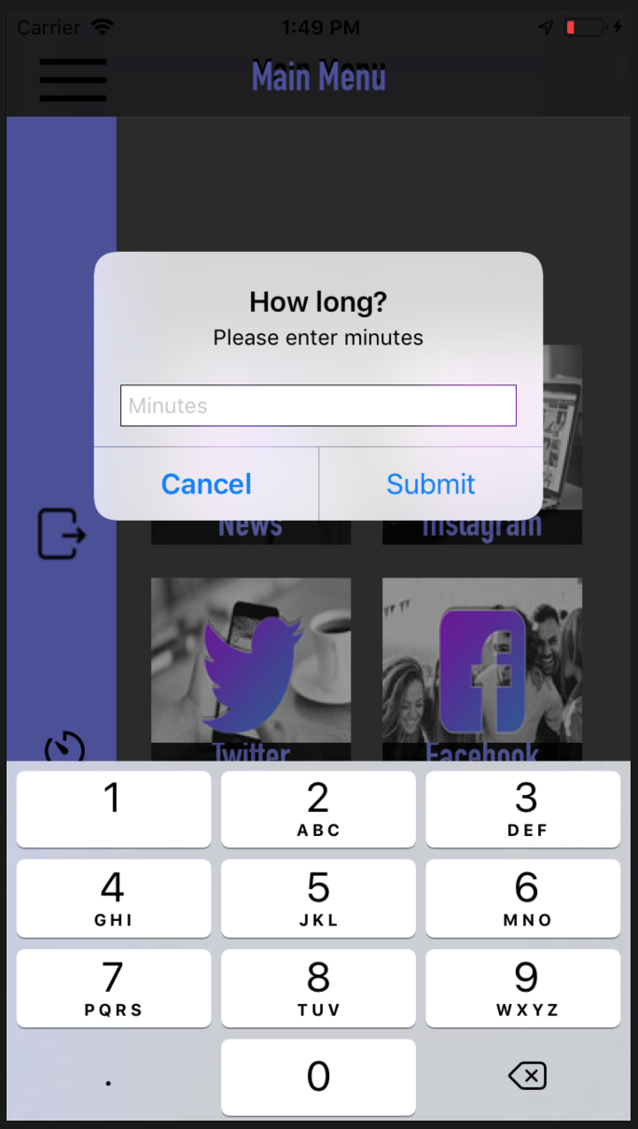
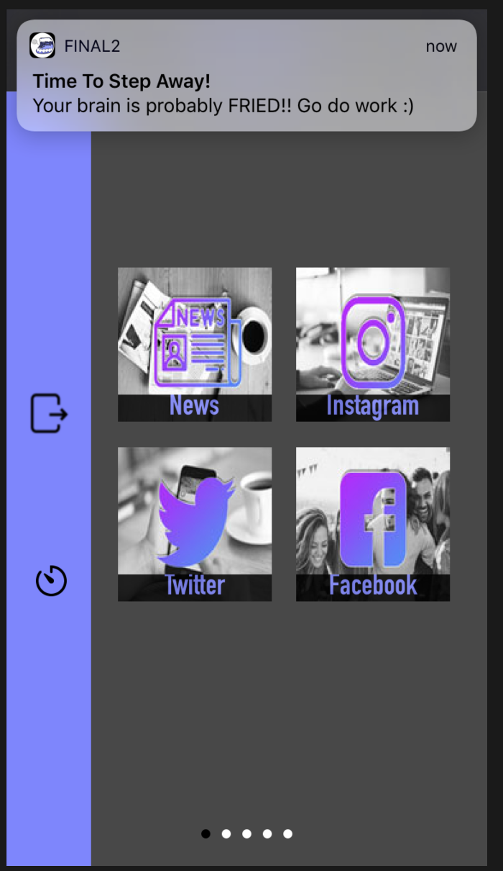
Timer feature
Local Notification:
we added a timer icon to our app to allow the user to enter how long they want to be using the app and when the time is up a notification will appear from their Notification center. We had to import UserNotifications framework in order to get the Notification Center functions and delegate. In this method we attached out timer button as an outlet and added an AlertController to produce a pop up which prompts the user for the time in minutes.
This is a non-repeating notification so the user can keep setting new ones.

